Slide 1
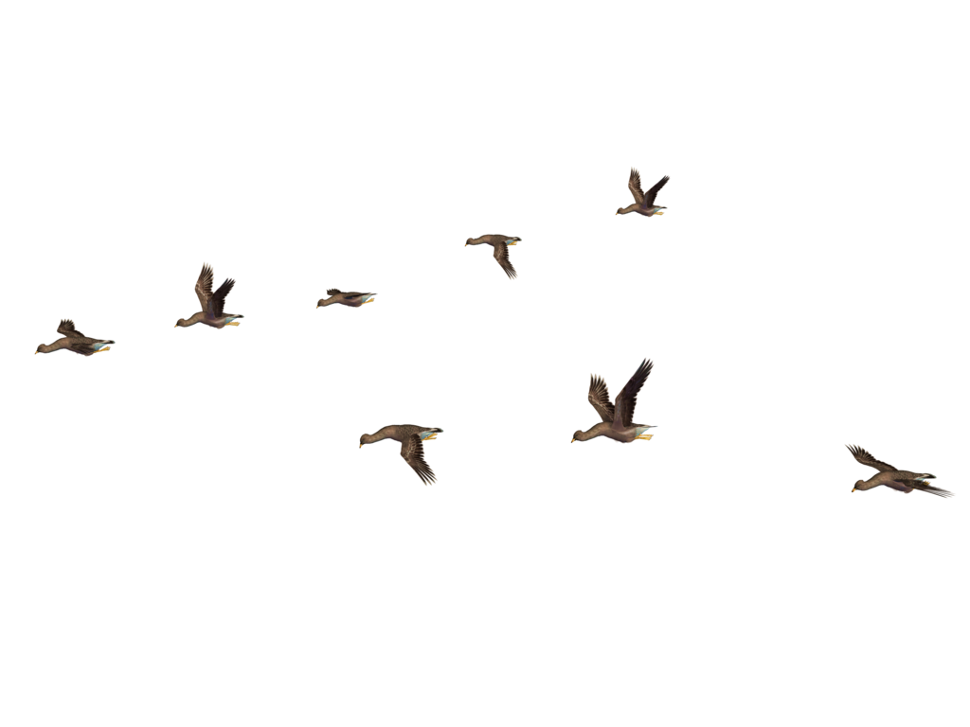
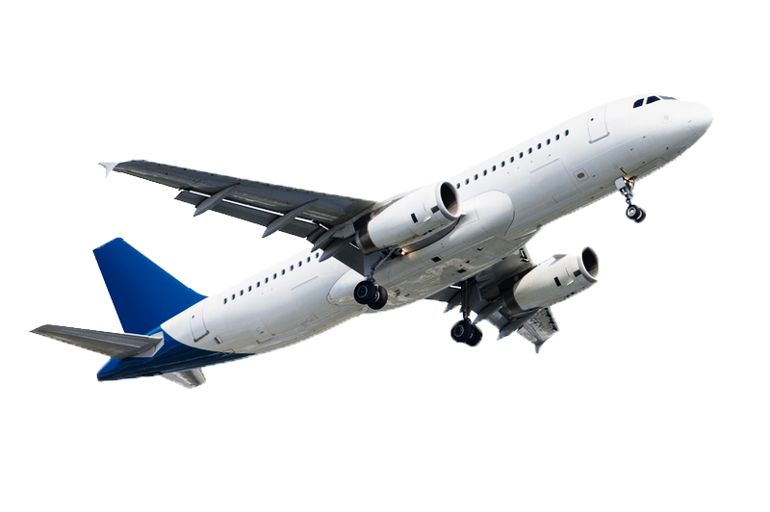
Data Visualization of Bird Strikes between 2000 – 2011
GNANA PRAKASH A

Slide 2
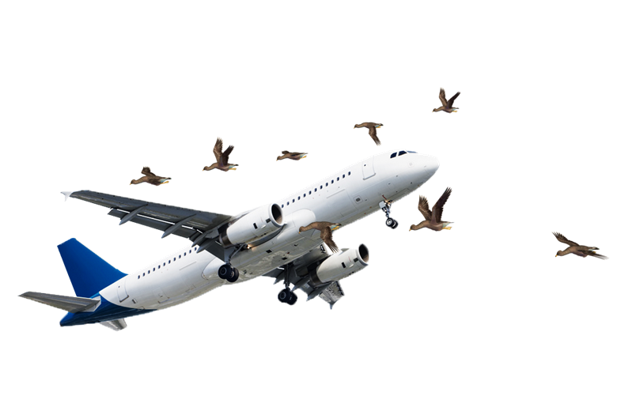
PROJECT : Data Visualization of Bird Strikes between 2000 – 2011
Introduction:
Bird strikes are a significant safety concern in aviation, causing potential damage to aircraft and risking passenger safety. This project aims to visualize bird strike data using Power BI, providing insights into the frequency, distribution, and impact of bird strikes. The goal is to help stakeholders, such as aviation safety authorities and airlines, understand and mitigate the risks associated with bird strikes.

Slide 3

Problem Statement:
A bird strike is strictly defined as a collision between a bird and an aircraft which is in
flight or on a take-off or landing roll. The term is often expanded to cover other wildlife
strikes - with bats or ground animals. Bird Strike is common and can be a significant
threat to aircraft safety. For smaller aircraft, significant damage may be caused to the
aircraft structure and all aircraft, especially jet-engine ones, are vulnerable to the loss
of thrust which can follow the ingestion of birds into engine air intakes. This has
resulted in several fatal accidents.
Bird strikes may occur during any phase of flight, but are most likely during the
take-off, initial climb, approach and landing phases due to the greater numbers of birds
in flight at lower levels. To have a closer look the following document visually depicts
the data collected on Bird Strikes by FAA between 2000-2011.

Slide 4
STEPS INVOLVED :
Data Cleaning and PreparationHandling Missing Data: Fill in or remove missing values as appropriate.
Standardization: Ensure data consistency in formats.
Removing Duplicates: Identify and remove duplicate records.
Visualization and ReportingInteractive Dashboards: Use tools like Tableau, Power BI, or Plotly to create interactive visualizations.

Slide 5
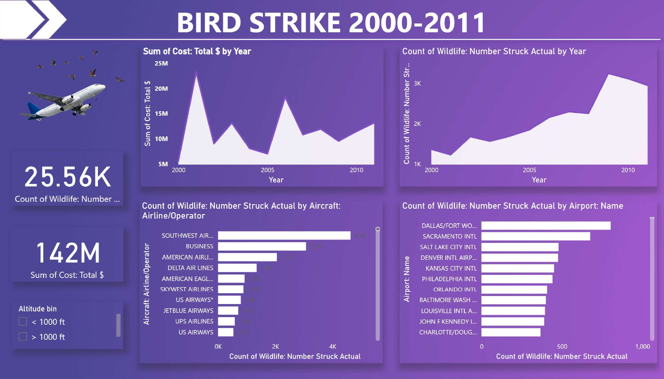
DASHBOARD :

Slide 6

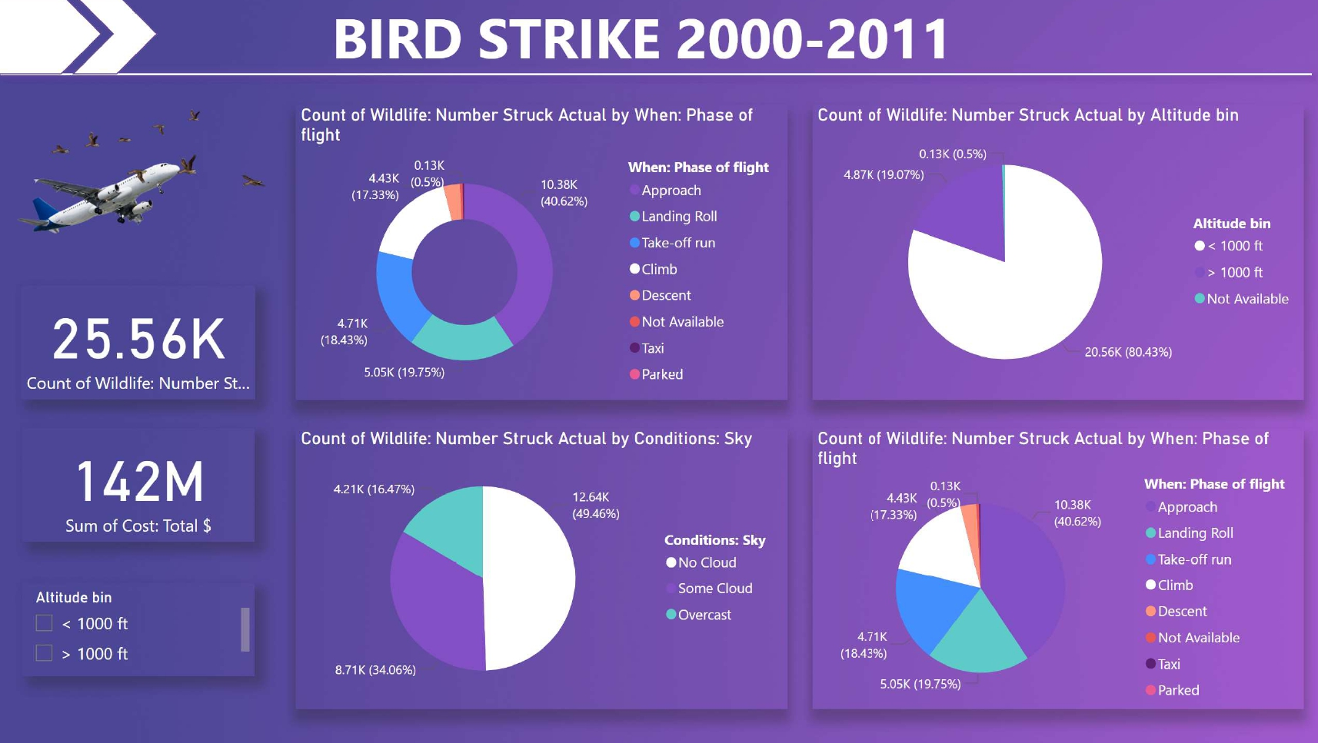

Slide 7
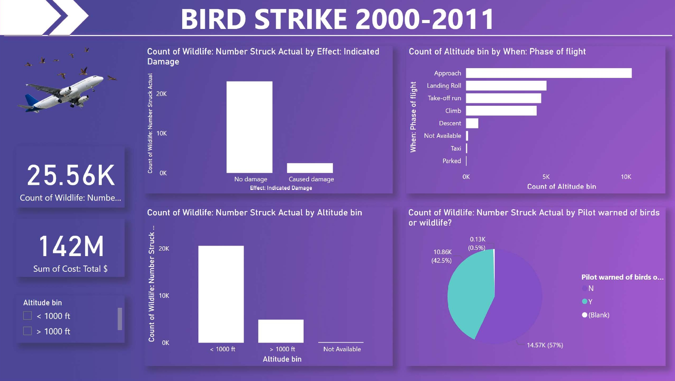

Slide 8
THANK YOU

